Slide 1

Recommender System
STADS Bootcamp FSS 2024 - Team 5
Hsien Yi-Wang
Ignatius Jordi Bernandi Harsawiguna

Slide 2
TABLE OF CONTENTS
01
02
03
OBJECTIVES
RECOMMENDER SYSTEMS
DEMO

Slide 3
01
OBJECTIVES

Slide 4
OBJECTIVES
CONTENT BASED RECOMMENDER
Build a movie recommendation system based on viewing history and
recommend movies/shows with similar “content.”

Slide 5
02
RECOMMENDER SYSTEMS

Slide 6
METHODOLOGY
Preprocessing
Embedding Generation and
Similarity Computation
Evaluation
App Development

Slide 7
8,807
5,390
275
113
Data 1
Data 2
PP Data 2
Data 1 ∩ PP Data 2
Movie Titles (EN), Metadata,
Short Description
Watching Logs, Watch Duration, Movie Titles (DE or EN)
Watched Movie Titles (DE or EN)
After Preprocessing
Overlapped Movie Titles
(EN)
Preprocessing Data 1:
Retain top 3 most famous actors (each movie) based on how frequent do they appear in the dataset
Preprocessing Data 2:
Preprocess title: The Big Bang Theory: Staffel 1: Penny und die Physiker (Folge 1) ⇒ The Big Bang Theory
Aggregate the viewing times for each movie
Excluding those watched for less than 30 minutes as valid watched history
Translating might not work:
Movie title can be totally different: Love at First Kiss (EN) ⇒ Du bist es (DE)

Slide 8
EMBEDDING GENERATION
APPROACH 1: TF-IDF
APPROACH 2: SENTENCE BERT
One embeddings
1. TF-IDF of movie description
Two embeddings
1. Sentence embedding of description
2. Sentence embedding of metadata
'the director is clint eastwood. the leading actors are morgan freeman, anthony mackie, mike colter. the movie is from united states. the movie is released in 2004. the movie falls within the genre of dramas, sports movies. '

Slide 9
SIMILARITY COMPUTATION
APPROACH 1: TF-IDF
APPROACH 2: SENTENCE BERT
Five similarity scores
1. Cosine similarity from TF-IDF of movie description
2. Whether having same director
3. Whether having same actors
4. Whether produced by same country
5. Whether falling within same genre
Two similarity scores
1. Cosine similarity from sentence embedding of description
2. Cosine similarity from sentence embedding of metadata
1 | 1 | 0
1 | 1 | 0
0 | 0 | 1
Movie 1 and Movie 2 have same director

Slide 10
EVALUATION
QUANTITATIVE
QUALITATIVE
Viewing history
Single history
Similarity score of Movie i - 1
Get the Rank of Movie i
Whole history
Based on Similarity score of Movie 1: i - 1
Get the Rank of Movie i
Viewing history
User prompt
See DEMO

Slide 11
EVALUATION
Approach | Embedding | Average Rank (Single History) | Average Rank (Whole History)
TF-IDF | Description | 2574.79 | 2843.24
TF-IDF | Description + Metadata | 2638.89 | 2307.49
SENTENCE BERT | Description | 3193.17 | 2809.83
SENTENCE BERT | Metadata | 3192.63 | 2935.71
SENTENCE BERT | Description + Metadata | 3052.91 | 2581.91

Slide 12
03
DEMO

Slide 13
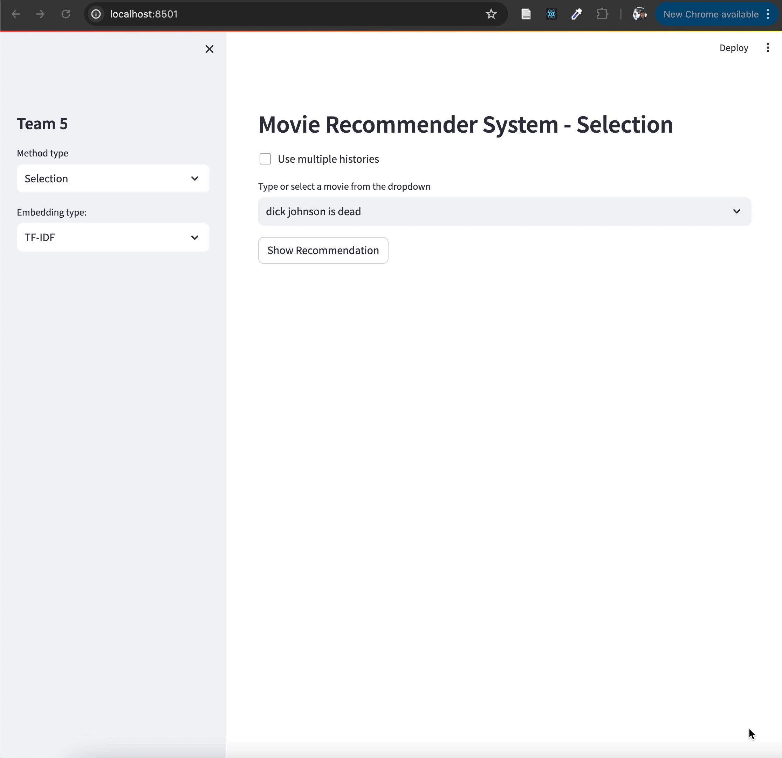
DEMO

Slide 14
THANKS!
Do you have any questions?

